Slide 1


Slide 2
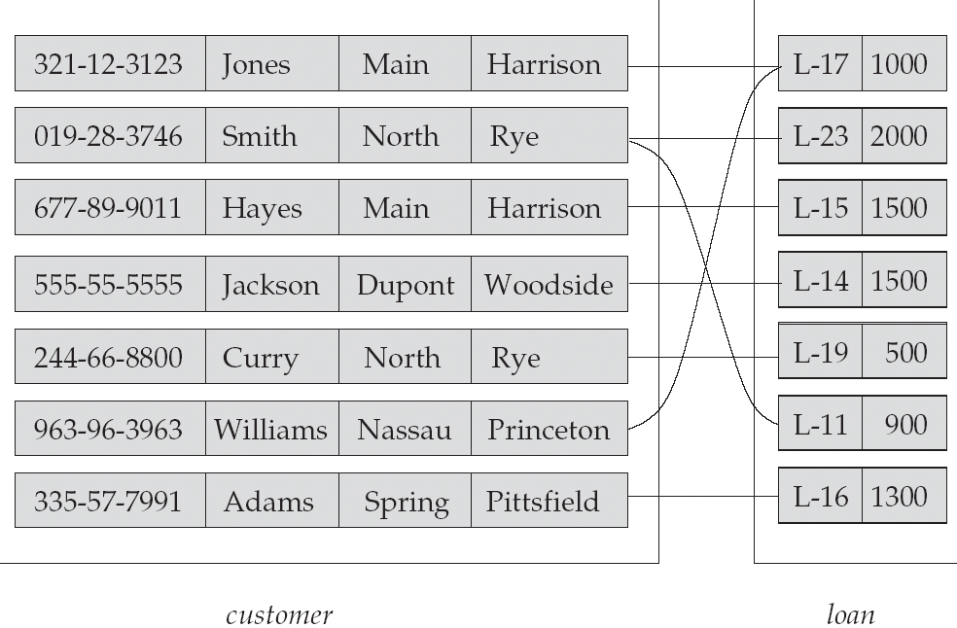
Relationship set ‘Borrower’
Relationship
Attributes
Cust_id cust_name street city
Loan no Amt
Entity
Entity Set

Slide 3
Entity :- An entity is a thing or object in the real world that is distinguishable from all other objects. Example:
Each person in an enterprise is an entity.
Entity Set :- An entity set is a set of entities of same type that share the same properties or attributes. Example:
The set of all persons who are customers at a given bank can be defined as the entity set customer.

Slide 4
Attributes :- Attributes are descriptive properties possessed by
each member of an entity set.
Each entity may have its own value for each attribute.
Example: customer_id , customer_name ,
customer_address are few possible attributes of the
entity customer.
Relationship :- It is an association among several entities.
Example: Hayes is a customer with loan no L-15.
So this relationship associates customer Hayes
with loan no L-15.
Relationship Set:- A set of relationships of same type.
Example: The relationship set borrower denotes
association between customers and the bank
loans that the customers have.

Slide 5
Relationship set ‘Borrower’
Relationship
Attributes
Cust_id cust_name street city
Loan no Amt
Entity
Entity Set

Slide 6
ENTITIES
There are two types of entities:-
Strong Entity- Entity types that have key attributes are
called strong entity.
Example : An employee(emp_id , ename, e-addr, dept_id)
Weak Entity-Entity types that do not have key attributes
of their own are called weak entities.
Example: Dependent of employees
(name, address, DOB, relationship).
Don’t have any existence without employees.

Slide 7
ATTRIBUTES
Different types of attributes are:-
Simple Attributes:- Attributes which cannot be divided into subparts.
Example- Roll No, Account no., etc.
2. Composite Attributes :- Attributes which can be divided into
sub-parts.
Example- Name, Address, etc
Name can be divided into First Name, Middle Name, Last Name.
Address can be divided into House No., Street Name, City Name,
State Name, Pin code.

Slide 8
3. Single Valued:- Attributes which have a single value for a particular entity. Example:- A person can have only one specific age.
4. Multivalued Attributes:- Attributes which have more than one value for a particular entity.
Example:- A person may have more than one phone no.
5. Derived Attributes:- The value of this type of attribute can be derived from the values of other related attributes or entities.
Example:- Age is a derived attribute and is said to be derivable from Date of Birth, which is again called a Stored Attribute.

Slide 9

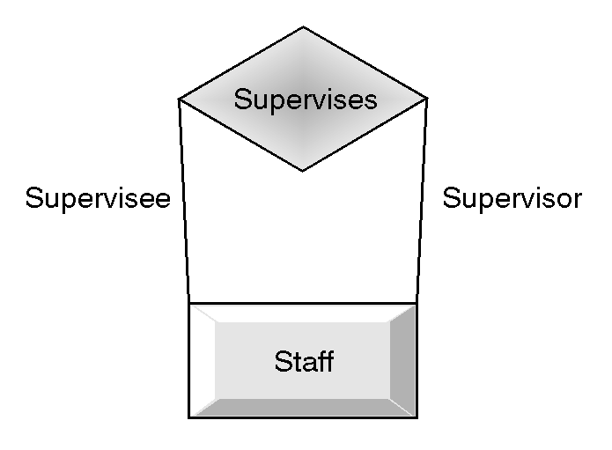
A relation having one entity set is called unary
relation or recursive relation.
Ex:

Slide 10
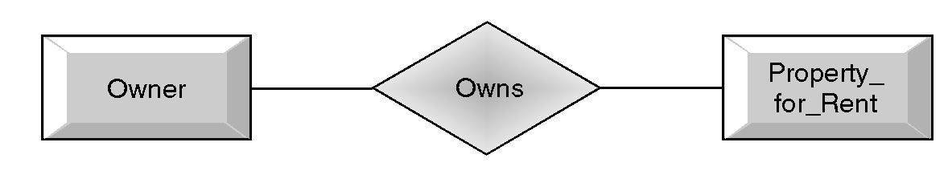
A relation having two entity sets is called
binary relation.
Ex:

Slide 11
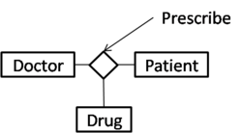
A relation having three entity sets is called ternary relation.
Ex:
Similarly, a relation having n entities is called n-ary relation.
The number of entities in a relation gives the degree of a relation.

Slide 12
Mapping Cardinalities: It expresses the no. of entities to which another entity can be associated via a relationship set.
For a binary relationship R between the entity sets A and B, the
mapping cardinalities must be one of the following:-
One –to-one:- An entity in A is associated with at most one entity in B and vice-versa.
ex: One manager manages one department.
One- to many:- An entity in A is associated with any no. of entities in B. However an entity in B can be associated with at most one entity in A.
Ex: One Teacher teaches many Students.

Slide 13
Many-to-one:- An entity in A is associated with at most
one entity in B. An entity in B can however be associated
with any no. of entities in A.
Ex: Many goods are produced by one company.
d) Many –to- many:- An entity in A is associated with any
no. of entities in B. An entity in B is associated with any
no. of entities in A.
Ex: Many engineers works for many projects.

Slide 14
Participation Constraints:
The participation of an entity set E in a relationship set R is said to be total , if every entity in E participates in at least one relationship in R.
Example: all employees of a department work in that department.
If only some entities in entity set E participate in relationship R, the participation is said to be partial.
Example: A manager(an employee) manages the department.

